Slide 1
https://grid.layoutit.com

Slide 2
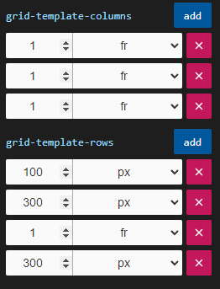
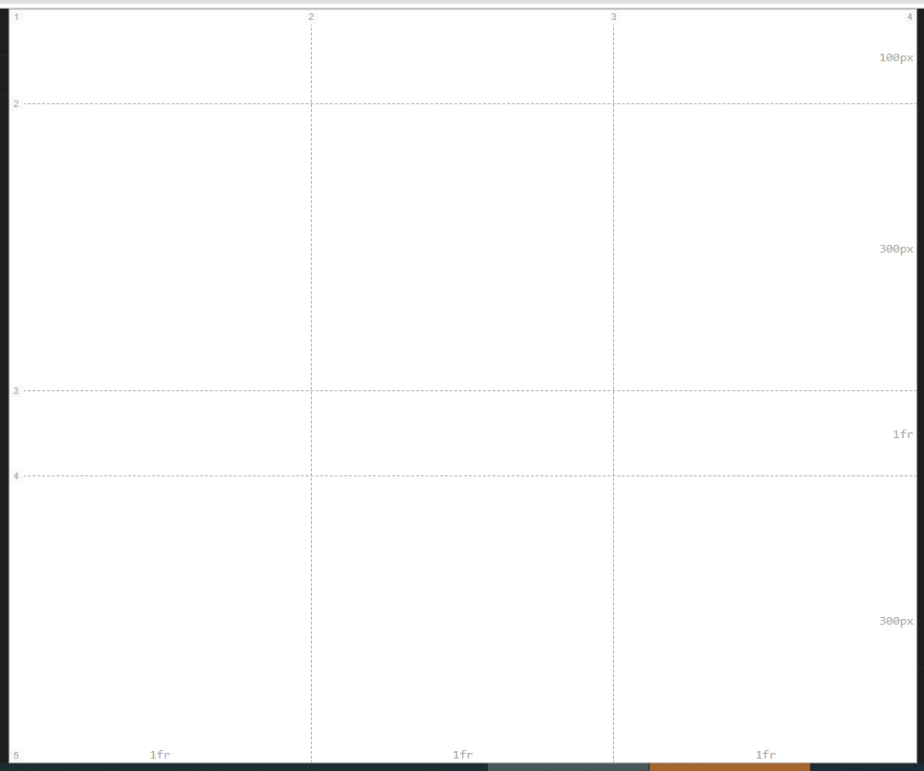

Slide 3
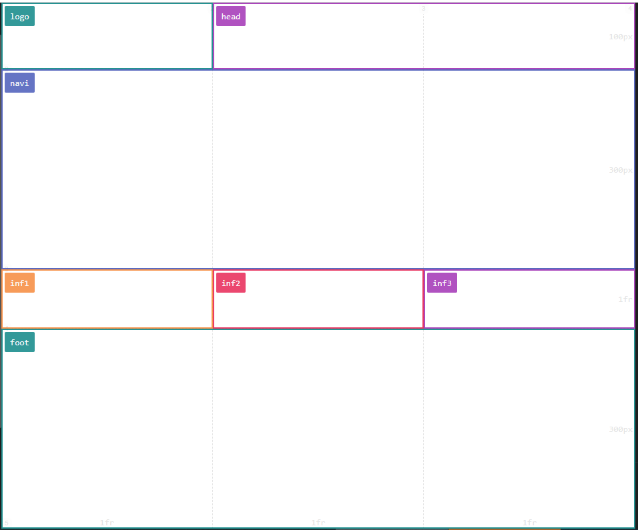

Slide 4
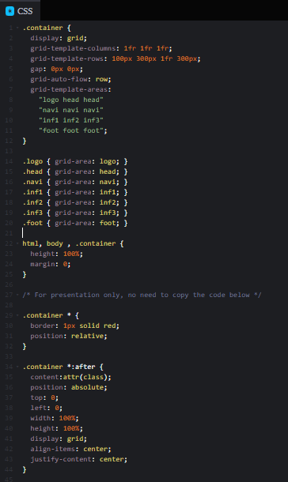
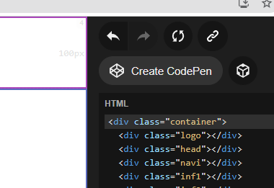

Slide 5
HTML5 tags:
https://developer.mozilla.org/en-US/docs/Web/HTML/Element
<header> - Defines a header for a document or a section
<nav> - Defines a set of navigation links
<section> - Defines a section in a document
<article> - Defines an independent, self-contained content
<aside> - Defines content aside from the content (like a sidebar)
<footer> - Defines a footer for a document or a section
<details> - Defines additional details that the user can open and close on demand
<summary> - Defines a heading for the <details> element

Slide 6
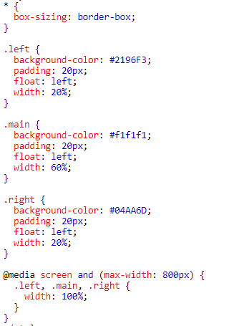

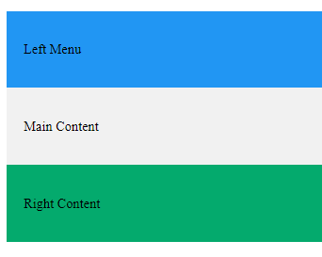
Responsive websites
https://www.w3schools.com/html/html_responsive.asp

Slide 7
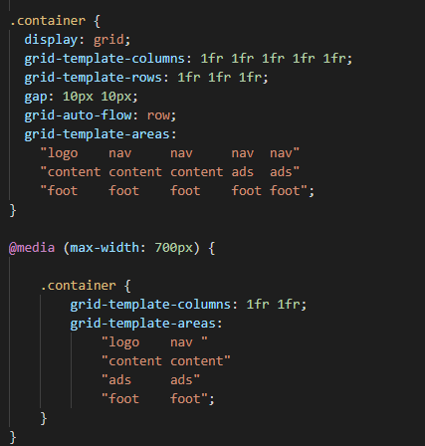
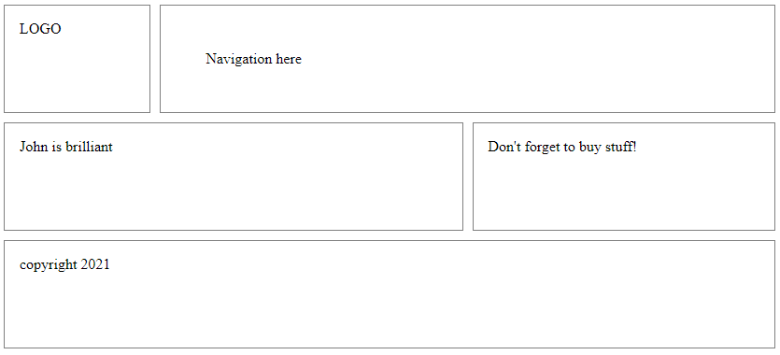
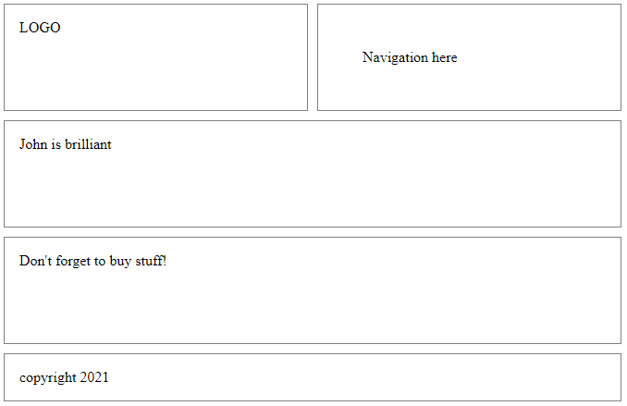
Changes:
2 columns
Different area

Slide 8
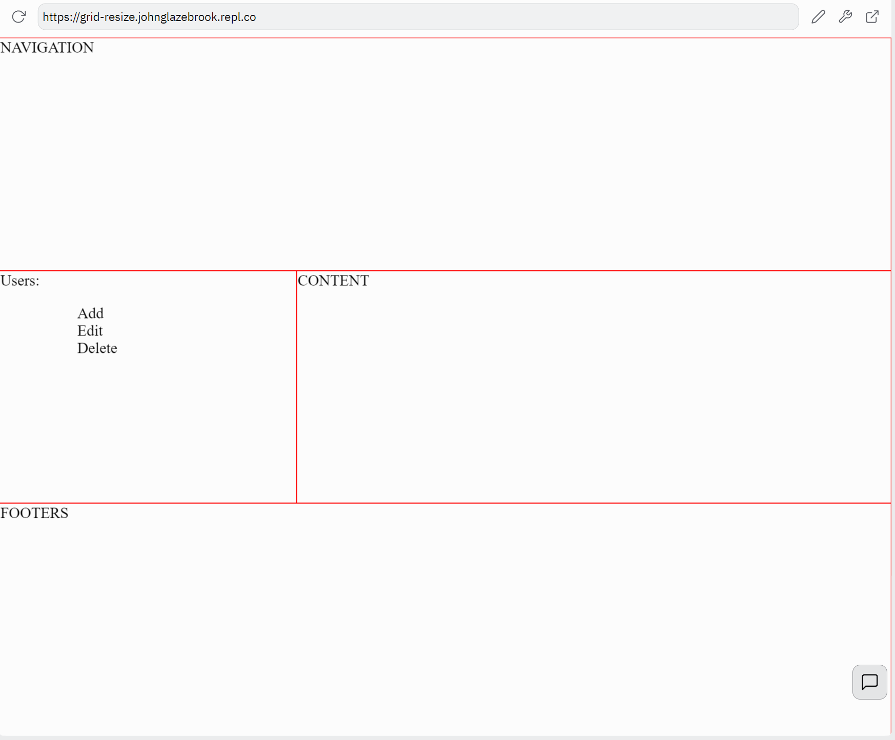
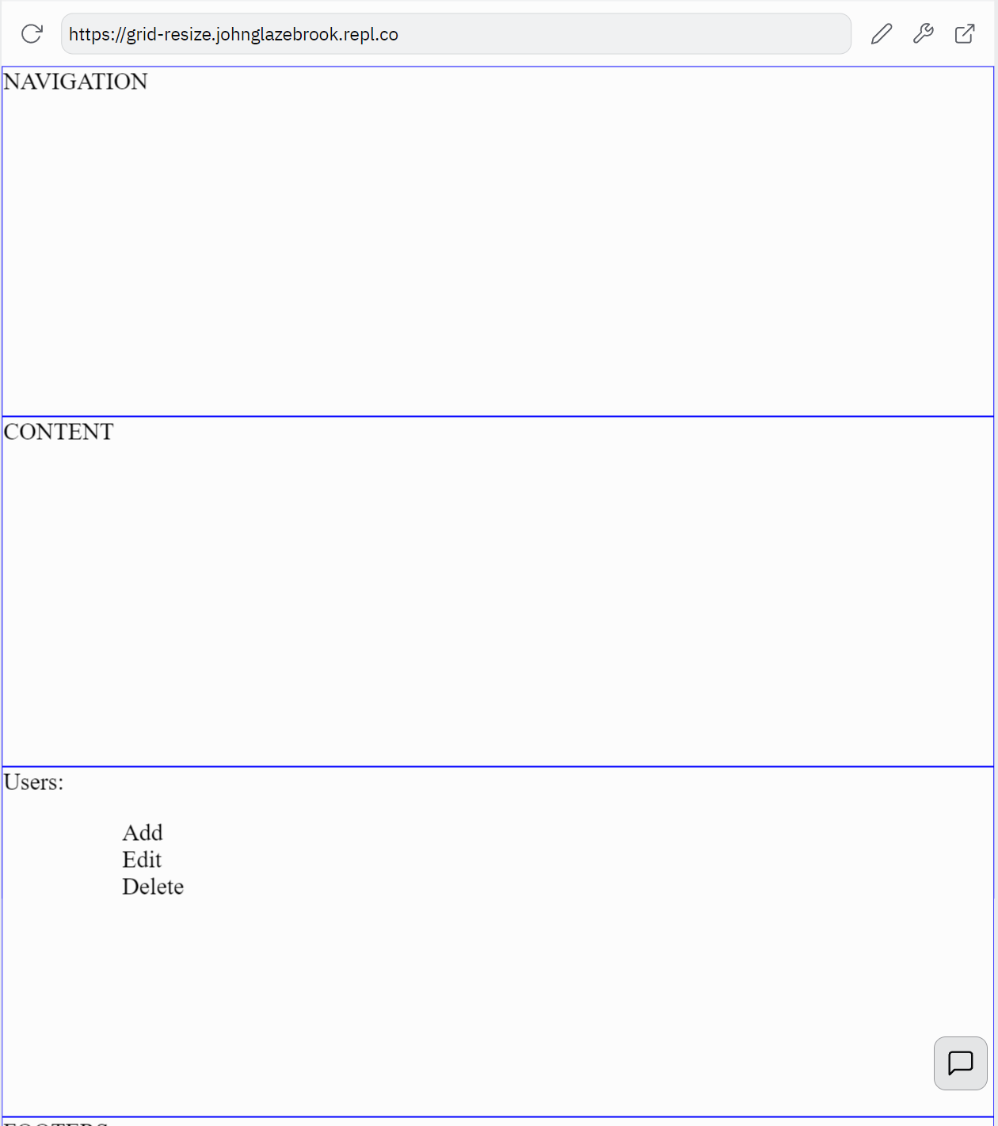
https://replit.com/@JohnGlazebrook/grid-resize#style.css

